Slide 1
Microservices and DevOps
DevOps and Container Technology
Docker Networking
Henrik Bærbak Christensen

Slide 2
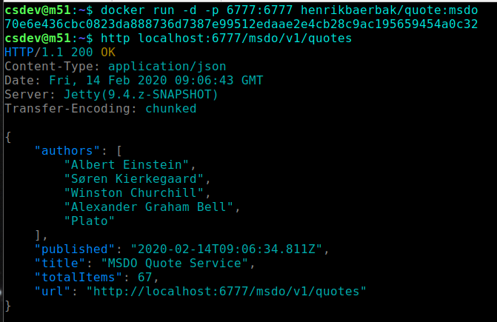
Port forwarding
Port forwarding is brilliant for local development / manual testing

Slide 3
Port forwarding
The liabilities of port forwarding
You expose the port on the host machine
(and docker opens that port in the firewall!)
And you cannot tie two services together using port forwarding!
Say start ‘SkyCave’ with a local ‘QuoteService’
Scenario
I start QuoteService container and port map so host has localhost:6777 access
I start SkyCave container and portmap on 7777, and CPF is configured to localhost:6777 for QuoteService
It doesn’t work!
Why not?
Notes:
Because in the skycave container, localhost:6777 is of course the local (skycave) container – no service is exposed on that port!

Slide 4
Container network
You can specify to use a named container’s network
This allows you to ‘tie’ services
Ex: start ‘skycave’ container on the quote service’s containers network, and use ‘localhost:6777’ to access

Slide 5
Container network
Still liabilities
Tying stuff together using localhost is bad practice
But you avoid exposing the port to the outside…

Slide 6
Host network
You can also state
--network host
Then the container reuses the host’s network
Similar liabilities

Slide 7
However, …
It sort of fails when we are going to build larger architectures…
Docker networks have it’s own internal DNS
docker run -- name mydb …
Will assign the container the name ‘mydb’ which can be used to contact it by any container on the same network
Docker can create (and manage) named networks
docker network create mynetwork

Slide 8
Production Class Network
The staging/production environment solution is to define a docker network, and tie containers together there.
Important: using ‘--name thename’ to define the node’s name
Similar to giving your machine a name on your home network

Slide 9
Restating
At the exam in CloudComputing 2016 I made an exam exercise which assumed my students knew that
It turned out 80-90 % never quite got that point!!!
The slaughter house exam
Everybody went out of the room in the firm conviction that they had just failed the exam ☹

Slide 10
TestContainers Pendant

Slide 11
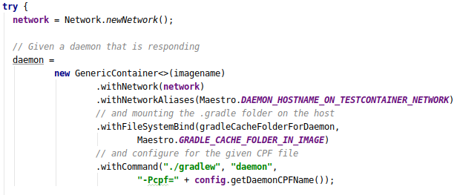
Network in TC
TestContainers support creating networks for testing
A peek into the Crunch interior:
docker network create NW
--network NW --name NAME

Slide 12
Summary
Docker has a rich set of ways to define and manage networks
(And network types – ‘none’, ‘bridge’, ‘overlay’, …)
Portmapping is great for local experimentation
And ‘container:theotherone’ comes in handy sometimes
For ‘real’ usage, use a docker managed, named, network
Swarm uses named networks
TestContainers support using named networks

